Slide 1
<Organization Name>
<logo>
ASN | <XXX>
Traffic Profile | Content / Eyeballs / Balanced
Traffic Volume | <xbps>
Peering Policy | Open / Selective / Closed
Peering Locations | (IXP/ DC/Location) Indicate especially Asia and Oceana
Peeringdb Entry | asxxx.peeringdb.com
Contact Information | <name>, email <peering@domain.com>
Photo
(optional)
Template for ISP/OTT/CDN

Slide 2
BKNIX Route Servers
ASN | 63529
Traffic Profile | Balanced
Traffic Volume | < 100 Mbps
Peering Policy | Open
Peering Locations | TCC Bangna CSL - CW Tower AIMS DC TH NTT BKK2
Peeringdb Entry | as63529.peeringdb.com
Contact Information | info@bknix.co.th , peering@bknix.co.th
Example

Slide 3
<Organization Name>
<logo>
IXP Name/s | <name1> | <name2>
Location | <City, Country> | <City, Country>
Point of Presence | <Data Center> | <Data Center>
# of connected ASNs | <count> | <count>
Peak Traffic | <xbps> | <xbps>
Route Server | No/Yes <BIRD/OpenBGPD/etc> | No/Yes <BIRD/OpenBGPD/etc>
Peeringdb/IXPdb | https://www.peeringdb.com/ix/xx | https://www.peeringdb.com/ix/yy
Photo
(optional)
Template for IXP

Slide 4
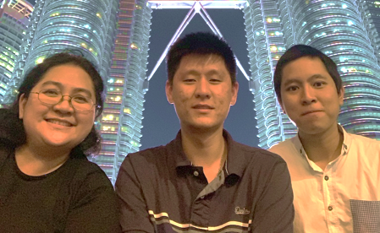
IXP Name/s | BKNIX | BKNIX Chiang Mai
Location | Bangkok, Thailand | Chiang Mai, Thailand
Point of Presence | TCC Bangna (supported by ISOC) CSL - CW Tower (supported by ISOC) AIMS DC TH NTT BKK2 (supported by ISOC) | Symphony (supported by APNIC)
# of connected ASNs | 39 | -
Peak Traffic | 56 G | -
Route Server | Yes <BIRD> | Will deploy soon <BIRD>
Peeringdb/IXPdb | https://www.peeringdb.com/ix/1025 https://ixpdb.euro-ix.net/en/ixpdb/ixp/587 | -
Example
Contact Information : info@bknix.co.th , peering@bknix.co.th
Patama Thanapat Nan

Slide 5
<Organization Name>
<logo>
Data Center | <name1> | <name2>
Location | <City, Country> | <City, Country>
IXP Presence | <IXPs> | <IXPs>
Photo
(optional)
Template for DC

